Slide 1
Genetic Incompatibility Lab
BIO 240L Spring 2023
Tyler Gandee, Dr. Karen Barnard-Kubow, Caylin Murray,
Dr. Alfredo López-Caamal, and Dr. Laura Galloway
Notes:
Slides from: Using Nanopore sequencing to assemble and compare chloroplast genomes: introducing genomics and bioinformatics into the classroom. Tyler Gandee, Caylin Murray, Alfredo Lopez-Caamal, Isobel Cobb, Laura F. Galloway, Joseph A. Harsh, Karen B. Barnard-Kubow. Nanopore related slides (slides 23-26) are taken from Oxford Nanopore Technologies’ Educational Slide Deck.

Slide 2
Learning objectives
Understand the concepts of speciation, reproductive isolation, genetic incompatibility, and how they are related
Understand the structure and function of organelle genomes
Be able to compare short versus long read high-throughput sequencing and know for which purposes each would be used.

Slide 3

How do new species form?
Santiago Ramierz Barahona
Notes:
Looking at the world around us we see a vast array of phenotypic and genetic diversity. This diversity leads us to ask the question of how new species form. Specifically, how does one species diverge, eventually giving rise to two new species. We call this process speciation.

Slide 4
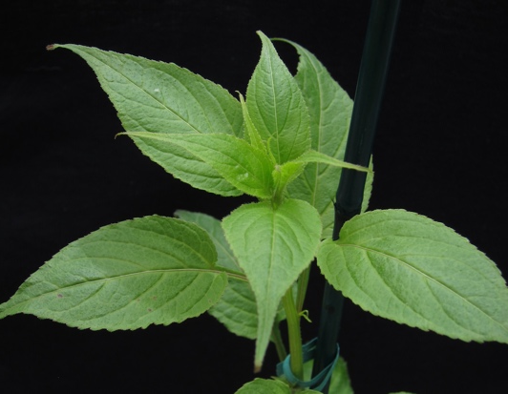
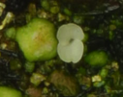
Speciation as a gradual accumulation of genetic incompatibility and thus reproductive isolation
What are the evolutionary processes that drive this overall process?
Notes:
We can think of the process of speciation as happening along a continuum. At one end we have populations of a species that are all genetically similar to one another. If you went out and crossed these populations, you would expect their offspring to do well. So, if we are thinking about plants, we would expect happy, healthy, green plants. Now something may happen to divide some of these populations from others. For example, a mountain range or a river may come between them, limiting gene flow. The populations then begin to evolve independently of one another, accumulating mutations. It could be that if you went out after some time and crossed these populations, you would now find that they still produce offspring, but those offspring no longer do very well. Since we are thinking about plants, they might be yellow, smaller and weaker, and produce fewer offspring. If enough time passes, and enough mutations accumulate, it could be that if you crossed these divergent populations they would no longer produce offspring at all, or if they do, those offspring are unable to survive or are sterile. At this point, we would say the populations are reproductive isolated and we would call them two different species. (This is the biological species concept). The question we would like to know, is what are the evolutionary processes that drive this overall process of speciation?

Slide 5
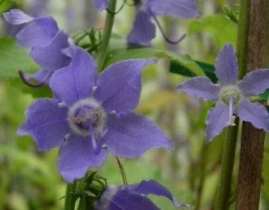
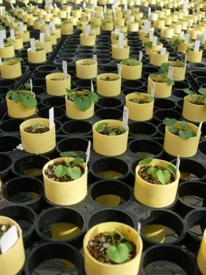
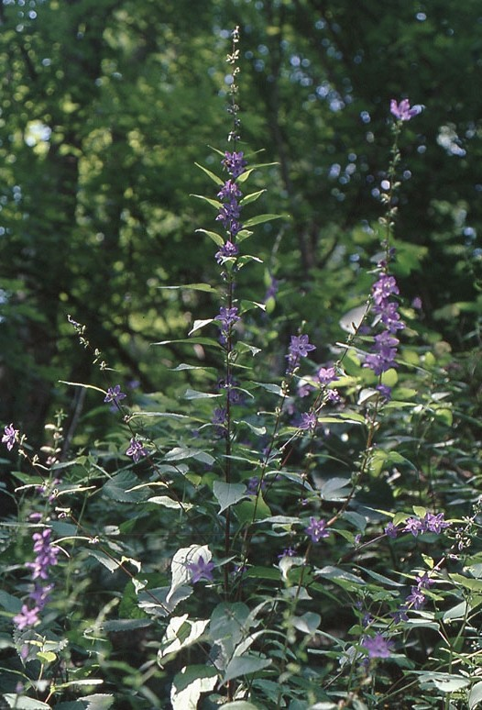
Campanula americana
(American Bellflower)
Notes:
To address this question, we work in the plant system Campanula americana. C. americana is a wildflower native to the United States. It is an herbaceous annual, which means its weedy. It can get tall, over 5 feet, and has beautiful purple flowers. There are three genetic lineages within the species when looking at the chloroplast genome. The Western lineage is found through most of the range, primarily west of the Appalachians though also some in the southern Appalachians. The Eastern lineage is found in the eastern Appalachians along with a few disjunct populations along the east coast. The more divergent Appalachian lineage is found in the Appalachian mountains. Now, what’s interesting about this system is….

Slide 6

Western
Western
Western
Appalachian
X
X
Notes:
As long as your cross population from the same lineage, you get happy healthy green plants. But, once you start crossing populations from different lineages, you begin to see genetic incompatibility and reproductive isolation. For example, when you cross Western and Appalachian populations, you can get these seedlings that are completely white. They are unable to photosynthesize and die with a week or two after germination.

Slide 7

Appalachian
Western
Western
Appalachian
Notes:
But what is even more interesting is that the direction of the cross is important. If an individual from an Appalachian population is crossed as the father with an individual from a Western population as the mother, you get happy, healthy, green plants. But, if you take the exact same two individuals, and reverse the direction of the cross, such that the Western lineage individual is now the mother, you get white seedlings that die with a week or two. How can simply reversing the direction of the cross lead to such drastically different outcomes?

Slide 8
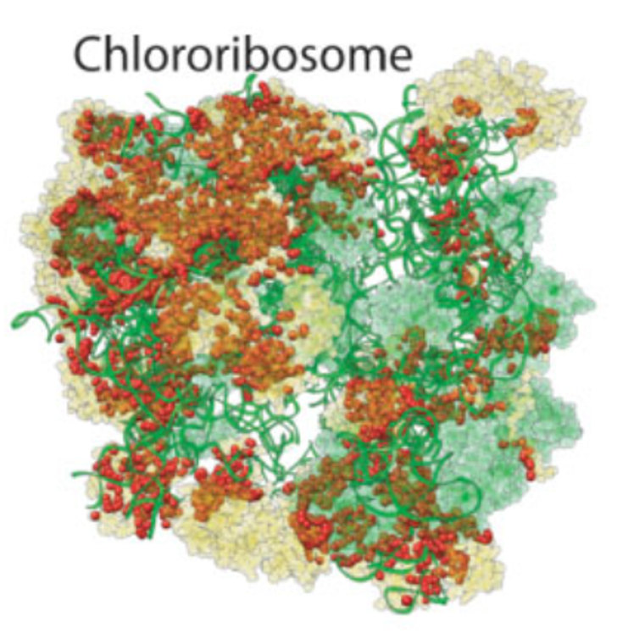
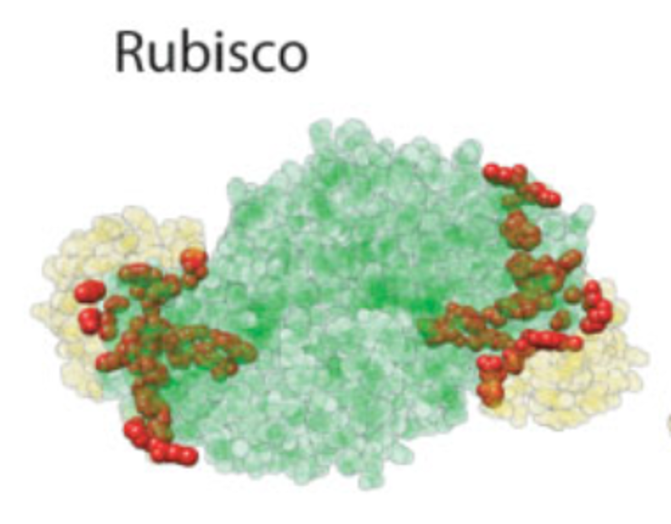
Eukaryotic cells contain not just a nuclear genome
Also contain one or more organelle genomes
Mitochondria
Chloroplast
M
C
Nuclear-encoded
Aa Bb
Chloroplast-encoded
Notes:
To understand what is going on we need to step back for a minute and think about the eukaryotic cell. Remember, a eukaryotic cell contains not just a nuclear genome, but one or more organellar genomes as well. Animals, like us, have a mitochondrial genome. Plants have both a mitochondrial and chloroplast genome. As you read in the pre-reading, the organelles originated as free living prokaryotes that were then endosymbiosed into an archaea like cell, forming the eukaryotic cell. Subsequently, most of the genes in the organelle genomes were then either moved to the nuclear genome or lost. As a consequence, most of the proteins that function in the organelles are now encoded in the nuclear genome and are sent back to the organelles in the form of proteins. However, some genes still remain in the organelle genomes. What this means, is that there are multiple protein complexes that function in the organelles that are made up of both nuclear and chloroplast encoded subunits. These subunits must cooperate together closely to ensure the functioning and survival of the cell.

Slide 9
Cytonuclear co-evolution
☺
Within lineage - coadapted
Respiration
Nuclear-encoded
M
C
Aa Bb
Plastid-encoded
Photosynthesis
☺
Notes:
Thus, we expect that within a lineage the nuclear and organelle genomes will remain well matched, or coadapted to one another. For example, if a mutation arises in one genome that impacts function, you might expect selection for a compensatory mutation in the other genome to maintain function, to ensure photosynthesis and respiration are working.

Slide 10
Cytonuclear co-evolution
Between lineage – mismatched?
Cytonuclear incompatibility!
☹
Respiration
Nuclear-encoded
M
C
Aa Bb
Plastid-encoded
Photosynthesis
☹
Notes:
However, when crossing between lineages, it may be that you end up with nuclear and organelle genomes, and thus proteins, that are mismatched, leading to reduced photosynthesis or respiration, and thus what we call “cytonuclear incompatibility”.

Slide 11
Nuclear versus organelle genomes
Nuclear
Biparentally inherited
From mom and dad
Linear chromosomes
Larger genome size
Organelle
Uniparentally inherited
Often only from mom
Circular genome
Smaller genome size
Notes:
It’s also important to remember that there are several key difference between the organelle and nuclear genomes. One important difference has to do with patterns of inheritance. Where do you get your nuclear genome from? Do you inherit it from your mother, father, or both? Both. 50/50/ But where does your mitochondrial genome come from? Only your mother. In flowering plants this is generally true for the organelles as well, that they are typically uniparentally inherited, from the mother. Some other important differences have to do with the structure of the genome. The nuclear genome in eukaryotes in present in multiple, linear chromosomes. And most of the DNA content in a eukaryotic cell is found in the nuclear genome. But remember, the organelles originated as free living prokaryotes, thus that have prokaryotic like genomes, in that they are circular. Organelle genomes are also much smaller than the nuclear genome. As a side note, organelles also retain other aspects of prokaryotic genomes, in that the organelle genes are frequently transcribed in operons.

Slide 12

Appalachian
Western
Western
Appalachian
What changes in the chloroplast genome cause this genetic incompatibility?
☺
☹
Notes:
OK, so taking this knowledge about eukaryotic cells and the differences between nuclear and organelle genomes, let’s get back to our plants. So, remember, when we cross an Appalachian lineage individual as mom with a Western lineage individual as dad, we get happy healthy green plants. When we carry out this cross, the resulting hybrid individual will have a 50/50 App/West nuclear genome. However, the organelle genomes only come from mom, from the Appalachian lineage. Thus, the Appalachian chloroplast appears to be perfectly happy with one copy of the Western nuclear genome. However, when we reverse the direction of the cross. The hybrid individual still has a 50/50 App/West nuclear genome, this has not changed, but now the organelles are coming from the Western population. In this case, we end up with a white seedling that cannot photosynthesize. Thus, it appears the the Western chloroplast is incapable of functioning with one copy of the Appalachian nuclear genome present. There appears to be a genetic incompatibility, or a mismatch, between the Western chloroplast and the Appalachian nuclear genome. This leads to the question, what changes have occurred in the chloroplast and nuclear genomes to lead to this strong incompatibility? For our work, we will be focusing on the chloroplast side of this question.

Slide 13
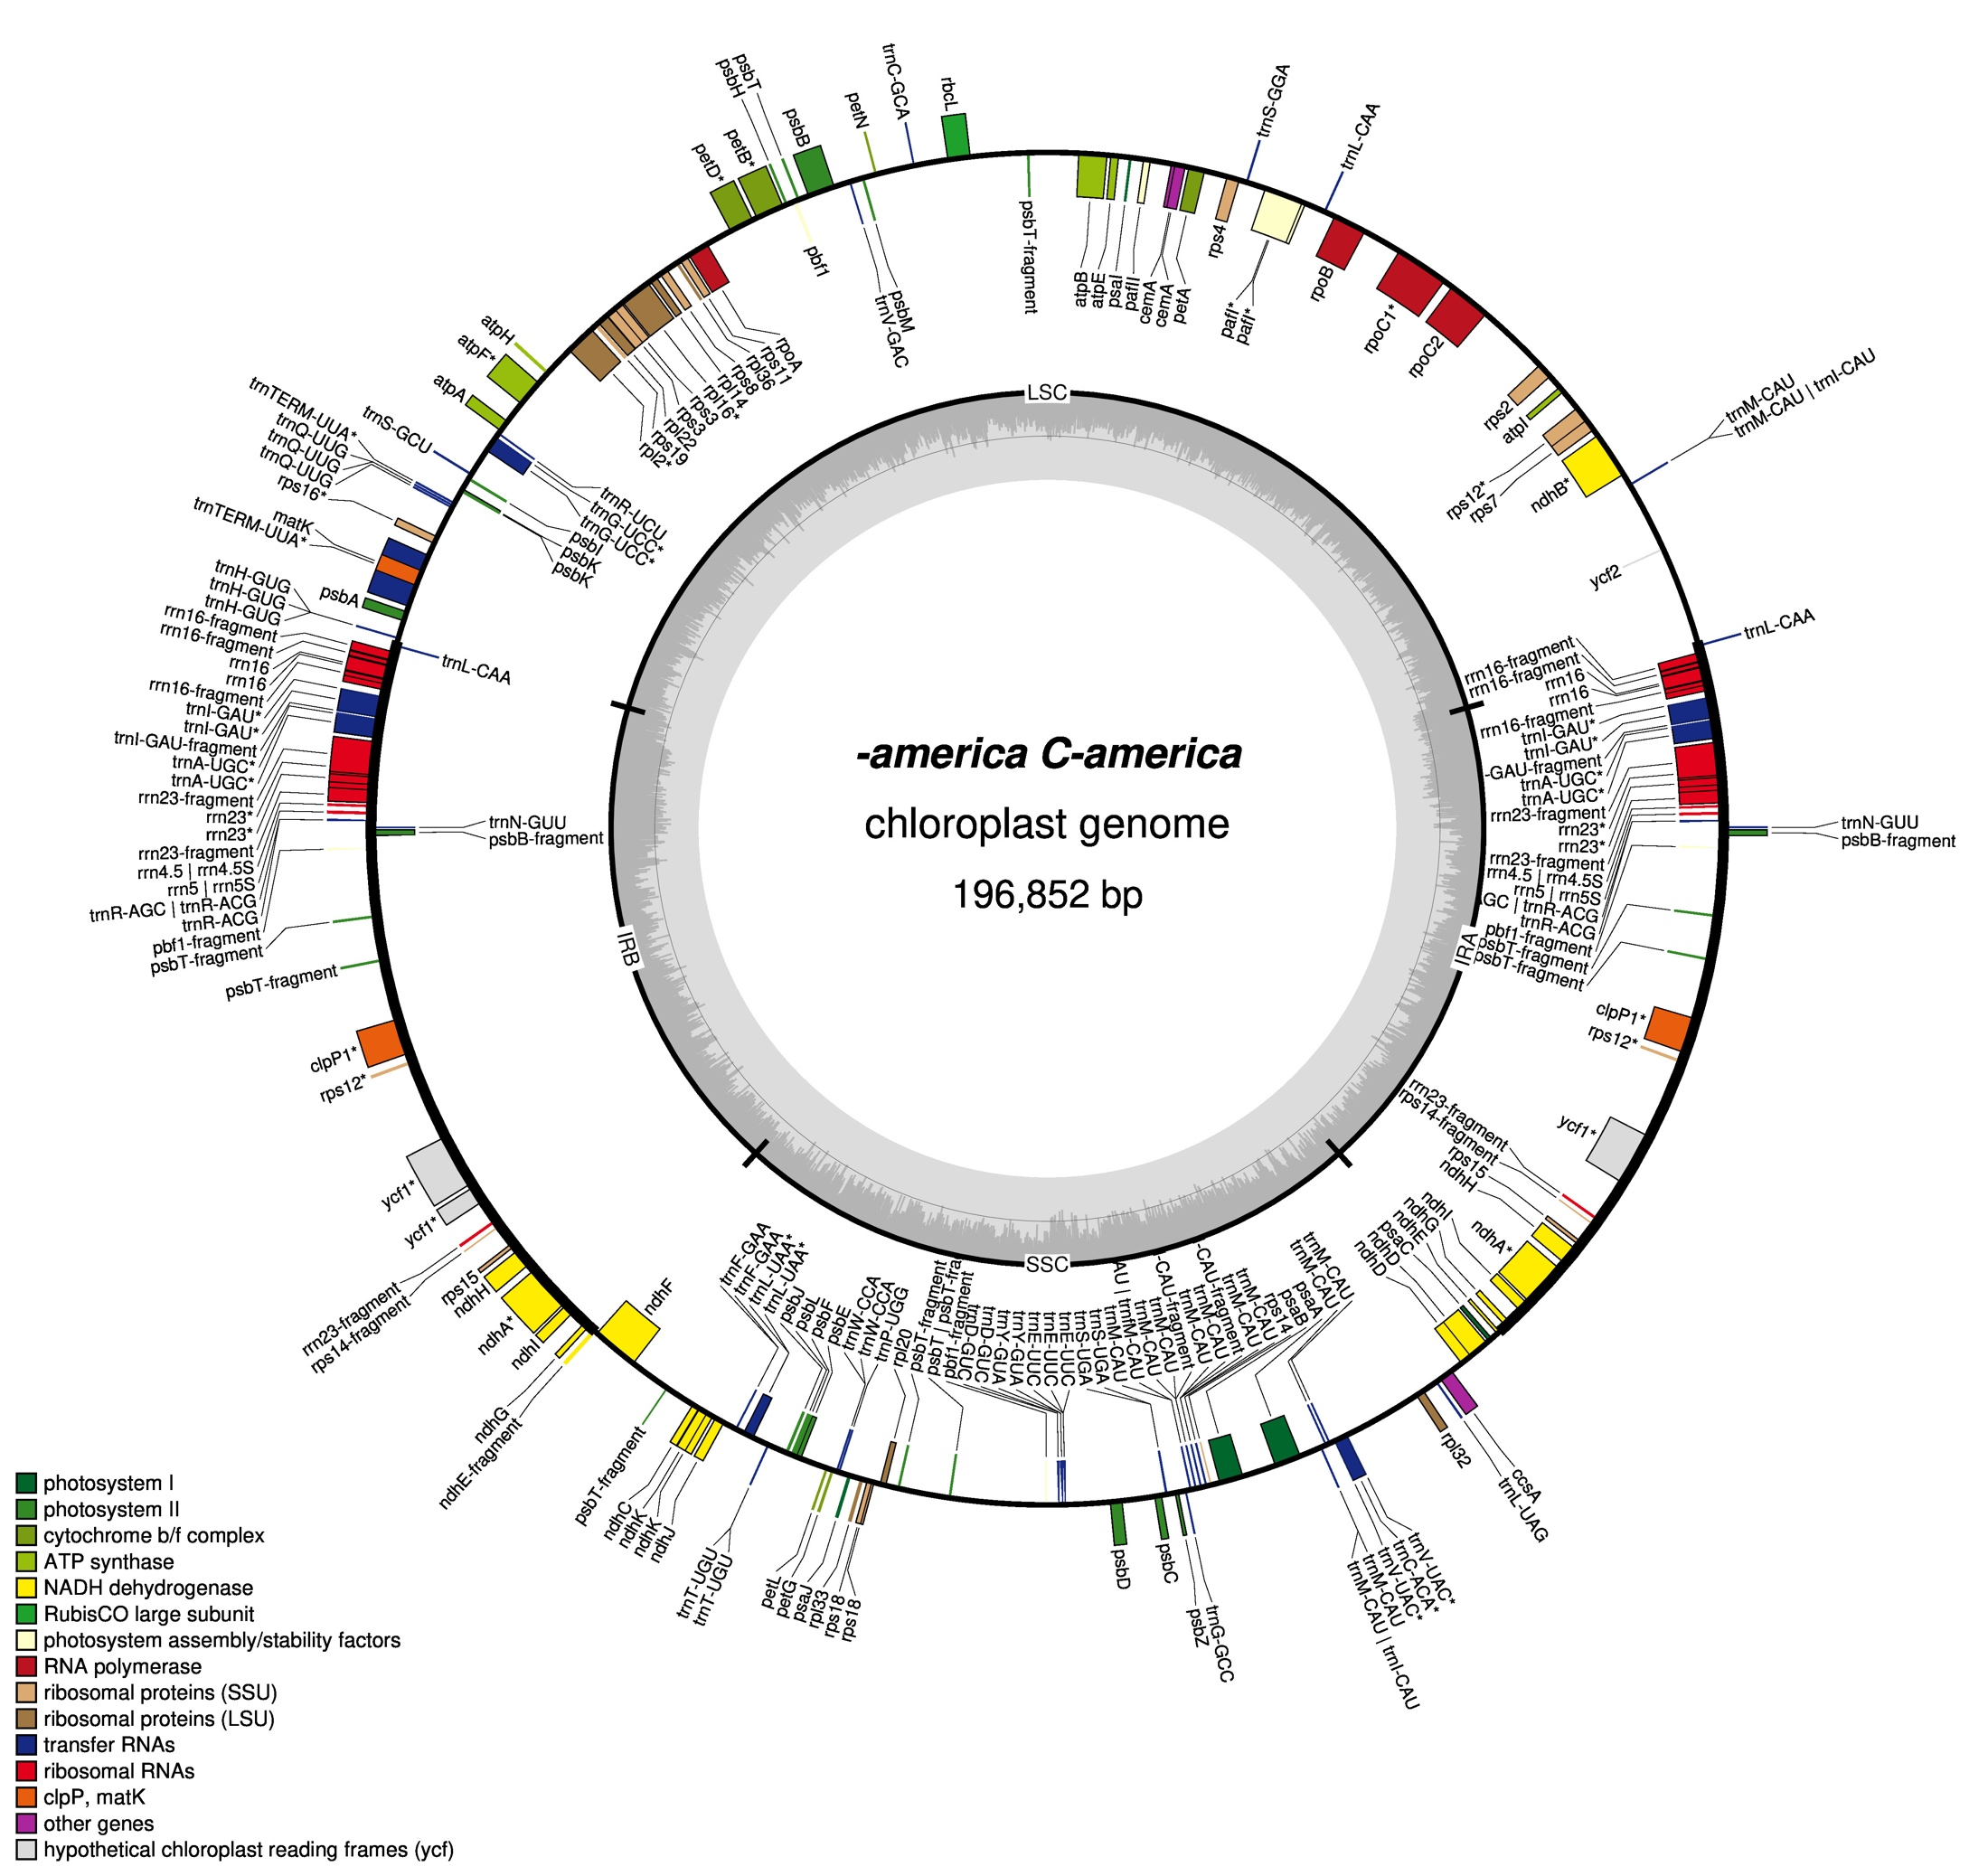
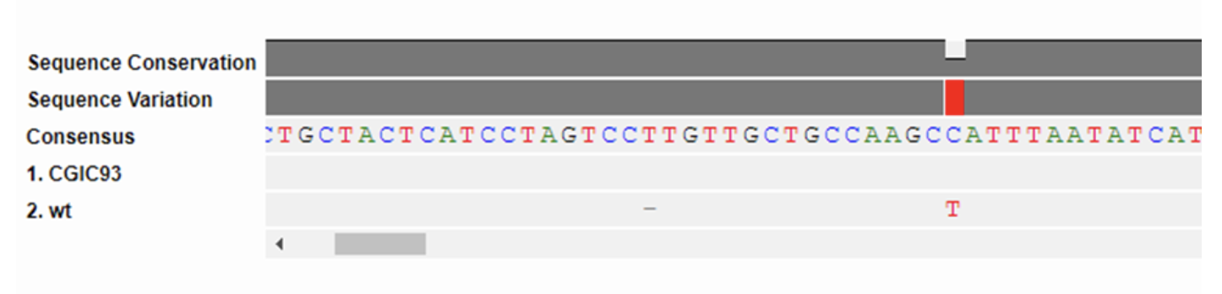
Types of genetic variation that could contribute to genetic incompatibility
Sequence level – point mutations
SNPs – single nucleotide polymorphisms
ATGCTAGTC
ATGGTAGTC
Campanula americana
Structural
Indels – insertions and deletions
Duplications
Inversions
Expansions/contractions of repetitive DNA
Notes:
When we are thinking about the types of genetic variation that could contribute to genetic incompatibility, these fall into two main categories. First, we have sequence level variation, which are point mutations. These are single nucleotide polymorphisms (or SNPs), where a single base is changed, for example an A to a G. Here we have an example of two sequences aligned in DNA subway and we can see that there has been a change from a C to a T. Second, we have structural level variation. This includes things like indels (insertions or deletions), duplications, inversions (where a chunk of sequence in flipped in orientation) and expansions and contractions of repetitive DNA. We are particularly interested in this last category, as we know that C. americana chloroplast genomes contain a large amount of repetitive DNA. Both types of variation have the potential to impact the expression and function of genes. Here I am showing you a diagram of C. americana’s chloroplast genome. Since we are talking about structural variation, I want to briefly touch on the structure of the chloroplast genome. It is circular and is unique in that is has what is called a quadripartite (four-part) structure. There is a pair of inverted repeats you can see on the side. This is a section of sequence that is duplicated. You can see it has the same genes in the same order (genes are represented by the colored blocks). The chloroplast genome can recombine at these inverted repeats. Separating the inverted repeats are a small and large single copy. Thus, a total of four parts.

Slide 14
Genetic incompatibility in C. americana
Crossing between chloroplast lineages leads to reduced survival
Survival
r² = 0.87 ***
Expected
Reproductive Isolation
Barnard-Kubow et. al. 2016, Evolution
Notes:
So, what do we know already? Here we are looking at results from a series of between-population crosses. Each point represents a cross between two populations. Blue diamonds are crosses between populations from the same lineage, while grey triangles are crosses between populations from different lineages. On the x-axis we have the chloroplast genetic distance between each pair of populations, represented as the number of SNPs in a handful of loci that were sequenced. On the y-axis we have the fitness of the hybrids for each cross relative to their parents. In this case we are looking at survival. Negative values indicate crosses where hybrids performed worse than their parents. For example, the lowest points here are around -55, which would mean those hybrids had a 55% reduction in survival relative to their parents. I hope you can see that as long as your cross within a lineage (blue diamonds) the offspring do fine. But, once you start crossing between lineages you begin to see reduced survival, and the extent of reduction is linearly related to the chloroplast genetic distance (# of SNPs). Thus, it appears that there is a relationship between sequence level variation (SNPs) in the chloroplast genome and the extent of genetic incompatibility and reproductive isolation. Can we conclude from this that these SNPs cause the incompatibility? No, correlation does not equal causation. But we can say there is a relationship of some sort.

Slide 15
Types of genetic variation
Sequence level – point mutations
SNPs – single nucleotide polymorphisms
ATGCTAGTC
ATGGTAGTC
Structural
Indels – insertions and deletions
Duplications
Inversions
Expansions/contractions of repetitive DNA
Appears to be related to genetic incompatibility
What about this?
How do we find out?
Notes:
Ok, we so can say that sequence level chloroplast genome variation appears to be related to genetic incompatibility. But what about structural variation? How do we go about investigating this question?

Slide 16
Is there a relationship between extent of structural variation in the chloroplast genome in C. americana and strength of genetic incompatibility?
Our approach
Cross plants from different genetic lineages
Germinate the seeds and score the strength of genetic incompatibility
Extract DNA from the parental plants and sequence the full chloroplast genome
Assemble the chloroplast genome de-novo
Compare de-novo assemblies from parental plants to score number of structural variants
Graph strength of genetic incompatibility against number of structural variants to determine if there is a relationship
Notes:
OK, this is the approach we are doing to take to address this question. Walk through the points on the slide. Point 1 was done by collaborators at UVA. Point 2 you all did last week, and we will score incompatibility based on phenotype in the next lab section. Outside of class we did DNA extraction of the parents of your seeds. You will prepare the libraries to sequence the chloroplast genome of the parents, which we will do on the sequence in the classroom. Then, you will use a bioinformatics workflow to assemble the chloroplast genomes for one parent of your seeds. You will then grab the assembled genome for the other parents from a different group and align the two genomes and score the number of structural variants. We will then collect the data from all the groups in the lab section and make a graph, with number of structural variants on the x-axis and strength of incompatibility on the y and ask if there is a relationship.

Slide 17
Is there a relationship between extent of structural variation in the chloroplast genome in C. americana and strength of genetic incompatibility?
Our approach
Cross plants from different genetic lineages
Germinate the seeds and score the strength of genetic incompatibility
Extract DNA from the parental plants and sequence the full chloroplast genome
Assemble the chloroplast genome de-novo
Compare de-novo assemblies from parental plants to score number of structural variants
Graph strength of genetic incompatibility against number of structural variants to determine if there is a relationship
Notes:
First I want to say a bit more about germinating and scoring the seeds.

Slide 18
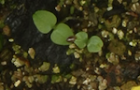
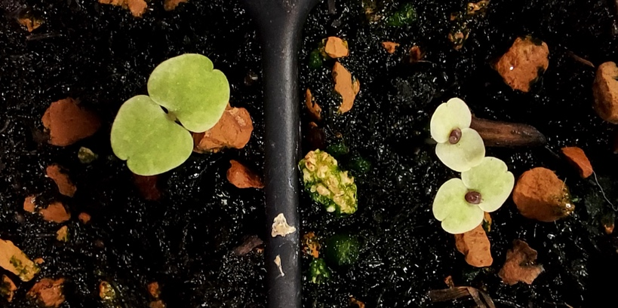
Scoring genetic incompatibility
Three types of crosses
Western x Eastern
Eastern x Appalachian
Western x Appalachian
Plant seeds on soil plates – last week
Score phenotypes – next class
Seedlings - green vs yellow vs white
Notes:
The seeds you planted came from three different types of crosses, based on which lineages were involved. You planted them on soil plates last week, and hopefully in two weeks everyone will have seedlings to phenotype. We can score them based on their color, which is indicative of the strength of genetic incompatibility. Green seedlings exhibit no incompatibility, yellow or mottled exhibit intermediate incompatibility, and white seedlings exhibit strong incompatibility.

Slide 19
Is there a relationship between extent of structural variation in the chloroplast genome in C. americana and strength of genetic incompatibility?
Our approach
Cross plants from different genetic lineages
Germinate the seeds and score the strength of genetic incompatibility
Extract DNA from the parental plants and sequence the full chloroplast genome
Assemble the chloroplast genome de-novo
Compare de-novo assemblies from parental plants to score number of structural variants
Graph strength of genetic incompatibility against number of structural variants to determine if there is a relationship
Notes:
So next we are going to sequence the full chloroplast genome from the parents of these seeds.

Slide 20
What kind of sequencing technology should we use to examine structural variation in the chloroplast genome?
Notes:
But before we do this, we need to decide which type of sequencing technology we should be using. Keeping in mind, we are focusing on structural rather than sequence level variation.

Slide 21
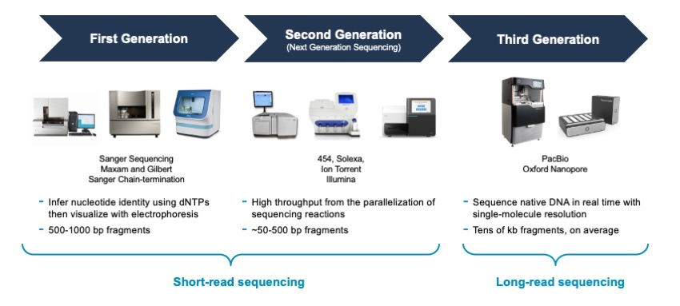
High-throughput sequencing
Lowest error rate, “gold standard”
Low throughput
Fairly low error rate
Highest throughput
Higher error rate
High throughput
Notes:
We can think of sequencing technologies as falling into three main types. First, we have Sanger Sequencing. You likely have done some form of Sanger Sequencing in the past in one of your biology labs. Sanger Sequencing is still considered the gold standard when you really want to know the sequence of a stretch of DNA. It has the lowest error rate. However, it has low throughput. You know from doing the yeast lab that when doing Sanger sequencing you get one read per sequencing reaction, and we typically do a forward and reverse read which we then combine to get our final consensus sequencer. Each read or sequencing reaction can cost $3-5. And reads are typically up to about 1000 bp in length. C. americana’s chloroplast genome is ~200,000 bp. This means to fully sequence the chloroplast genome we would need 200 pairs of primers, and then do a forward and reverse read for each PCR product, which would be ~400 sequencing reactions. This would not only be a costly, but also time intensive way to sequence the chloroplast genome. So, Sanger sequencing is out. For sequencing the chloroplast genome, we need a more high-throughput sequencing technology, which is often called next generation sequencing. Within next generation sequencing, there are two main types of sequencing technologies. Short-read, and long-read technologies. In the short read space Illumina dominates the market. (FYI the 454 technology is obsolete, and there are very few Ion torrents in use). Illumina short read sequencing still has a relatively low error rate (though higher than Sanger), but the reads are relatively short, typically between 50 and 300 bp long. There are two main technologies in the long-read high NGS space, PacBio and Nanopore. Both have higher baseline error rates than Illumina, though PacBio has a cool way of lowering error rates by circularizing individual DNA molecules and sequencing them multiple times, and calling a consensus. However, this also limits to the lengths of their reads (more like 20-40 thousand base pairs). Nanopore sequencing has a higher error rate, though it is getting better over time with new chemistries, but it has by far the longest reads. You can even get reads that are over a million base pairs long. PacBio sequencers are the largest sequencers and are very expensive. Nanopore’s MinION sequencer, on the other hand, is small and portable, and relatively inexpensive (starter kits are between $2,500 and $5000).

Slide 22
Types of genetic variation – how do we identify these?
Sequence level – point mutations
SNPs – single nucleotide polymorphisms
ATGCTAGTC
ATGGTAGTC
Structural
Indels – insertions and deletions
Duplications
Inversions
Repetitive sequence
Short-read high-throughput sequencing
High sequence accuracy
Short read length
Long-read high-throughput sequencing
Lower sequence accuracy
Long read length
Notes:
OK, so thinking about the different strengths and weaknesses of short, versus long-read next generation sequencing, which technology would be best for looking at different types of genetic variation? Let’s say we were really interested in sequence level variation, identifying individuals SNPs. In this case, which technology would be the best to use? Yes, short-read sequencing, because it has the lowest error rate. However, what if we want to look at structural variation? Which technology should we use in this case? That’s right. For structural variation long-read sequencing is a better choice. Think about it this way. Let’s say we have a complex repeat that is 100 bp long, and there are many copies of this repeat. Would 300 bp Illumina reads be sufficient to determine how many repeats are present? No. However, a long read could go all the way through the repetitive sequence. Accordingly, we will be using long-read sequencing to sequence our C. americana chloroplast genomes.

Slide 23
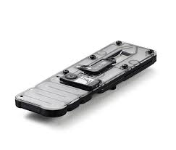

Our approach – Long-read high throughput sequencing to sequence the chloroplast genome
Nanopore’s Minion Sequencer
Nanopore’s Rapid Barcoding library prep
Load and sequence on a Minion flow cell
Notes:
And perhaps not surprisingly (given the small size and relative affordability), we will specifically be using Nanopore’s MinION sequencer for doing our sequencing. This way, we can do the sequencing right here in the classroom. Now, before we go any further, I would like to talk about how Nanopore sequencing works, because likely most of you have not heard of this technology before.

Slide 24
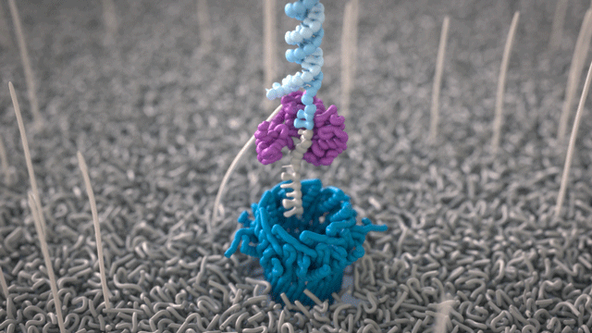
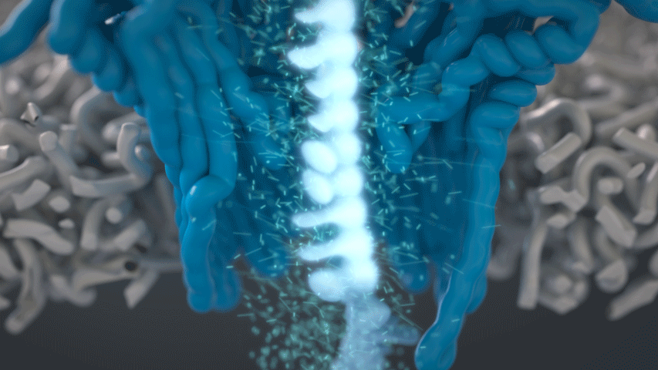
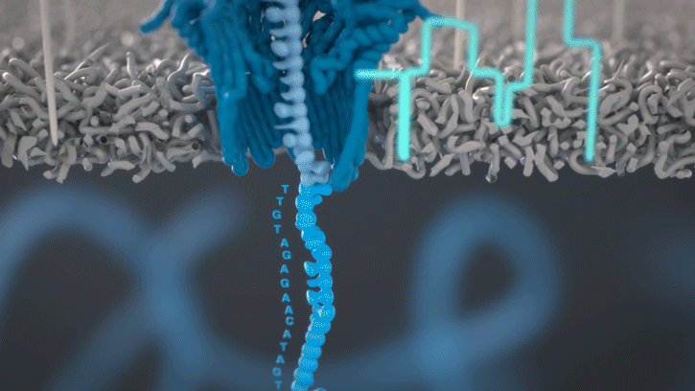

How nanopore sequencing works
1.
A motor feeds DNA through a nanopore
2.
The DNA blocks the flow of current through the pore
3.
The changes in current are decoded into the DNA sequence – this is called basecalling
Watch the full video on how nanopore sequencing works
Notes:
Slide from Oxford Nanopore Technologies
Teaching points:
A nanopore sits in a membrane, DNA is fed through
The DNA blocks an electrical current depending on what base is present in the pore
This digital method of reading DNA sequence has multiple benefits
NOTE – either slide 1 or 2 could be used to explain this

Slide 25
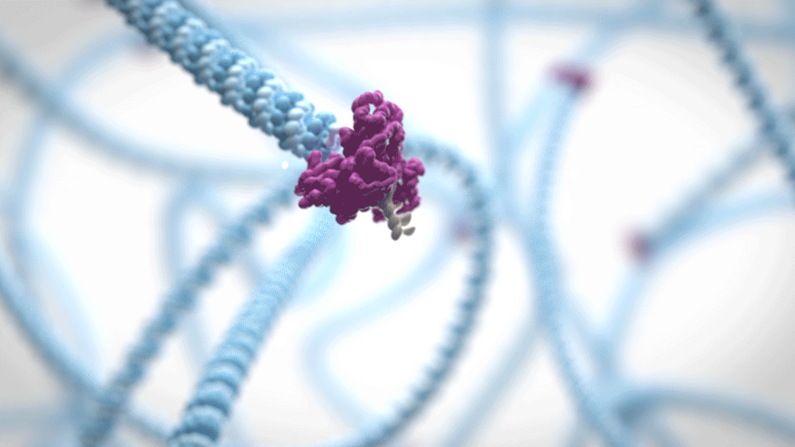
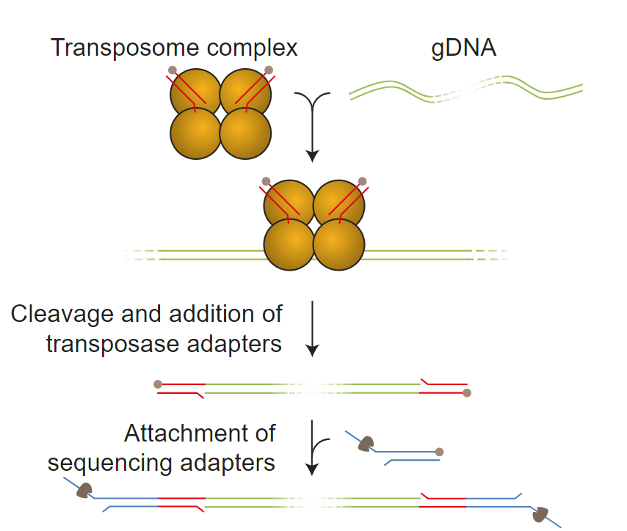
Preparing DNA for nanopore sequencing
Enzyme complex
DNA
1. Cuts DNA
2. Adds “glue”
DNA strand
Adapters with motor protein added to the end
Motor protein
Moves the DNA through the pore
3. “Sticks” on adapters
Notes:
Slide from Oxford Nanopore Technologies
Teaching points:
DNA must be prepared for sequencing by adding an adapter, containing a motor protein
The motor protein (a helicase) is responsible for controlling the movement of DNA through the pore
The “rapid” approach to library preparation uses a transposase to chop up DNA and add special chemical groups that can then be stuck to these adapters

Slide 26
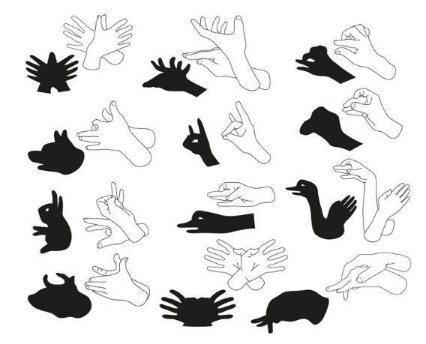
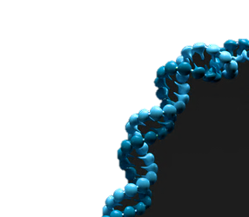
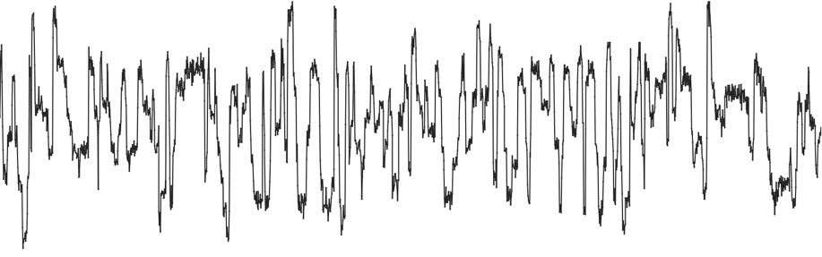
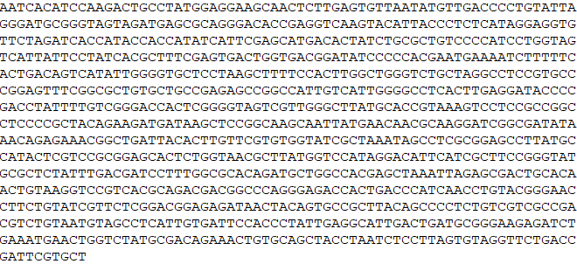
How does basecalling of nanopore data work?
The shadow puppet analogy
DNA…
…into current…
The hands block the light
Because the hands are a certain shape, it creates a shadow we recognise
Each base of DNA blocks the current
Because the bases are a certain shape and size, it creates a signal we can recognise
…and the current into bases
Notes:
Slide from Oxford Nanopore Technologies
Teaching points:
The shadow puppets show how blocking light leads to an obvious signal – the shape of the shadow produced
Nanopore sequencing operates on the same principle, but relies on blocking an electrical current with bases. The obvious signal is the amount of current blocked

Slide 27
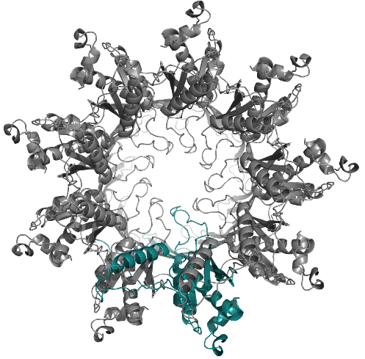
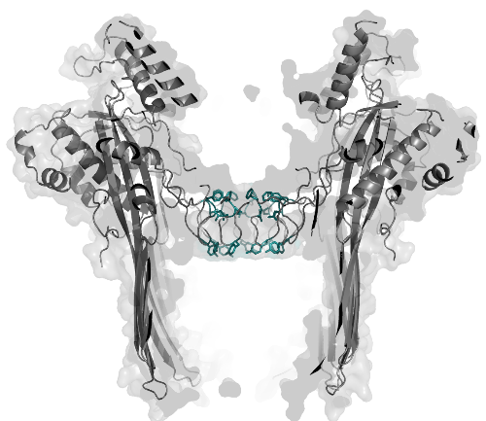
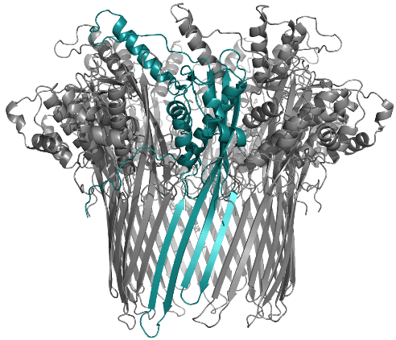
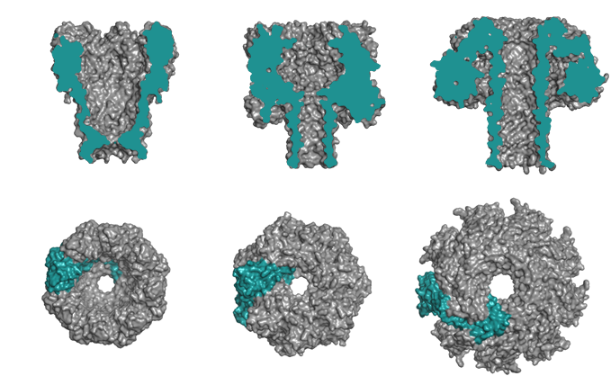

Where do nanopores come from?
They exist in nature but are engineered for nanopore sequencing
This is the CsgG pore
A nine-subunit protein from the outer membrane of E.coli
In nature it facilitates excretion of amyloid proteins for biofilms
Lots of nanopore families exist
They exhibit different structures
They may be useful for different applications
Read more about CsgG
Notes:
Slide from Oxford Nanopore Technologies
Teaching points:
Protein nanopores exist naturally and have multiple differing functions
The CsgG nanopore is used to transport proteins across the E.coli membrane, for example
Whatever nanopore is used can be engineered to optimise its signal, through classic molecular biology techniques utilising the central dogma of DNA → RNA → Proteins

Slide 28
https://nanoporetech.com/support/how-it-works#fullVideo&modal=fullVideo
Notes:
Now let’s watch a video. I always enjoy watching videos and this one does a good job of summarizing how Nanopore sequencing works.

Slide 29
Is there a relationship between extent of structural variation in the chloroplast genome in C. americana and strength of genetic incompatibility?
Our approach
Cross plants from different genetic lineages
Germinate the seeds and score the strength of genetic incompatibility
Extract DNA from the parental plants and sequence the full chloroplast genome
Assemble the chloroplast genome de-novo
Compare de-novo assemblies from parental plants to score number of structural variants
Graph strength of genetic incompatibility against number of structural variants to determine if there is a relationship
Notes:
OK. So, after we sequence, assemble, compare, and score structural variation between the chloroplast genomes of the parents of your seedlings, and phenotype your seedlings, we will gather everyone’s data together and make a graph to look at the relationship between structural variation and genetic incompatibility.

Slide 30
What relationship do you expect?
Strength of genetic incompatibility
Number of structural variants
Notes:
OK, we are going to graph the number of structural variants on the x, and strength of incompatibility on the y (notice in this graph incompatibility is increasing as we go up). If we hypothesize that structural variation is contributing to genetic incompatibility, what type of relationship or line would we expect to see on this graph? Positive, negative, or no slope? Yes! Positive slope! Let’s see what we get!

